Slide 1
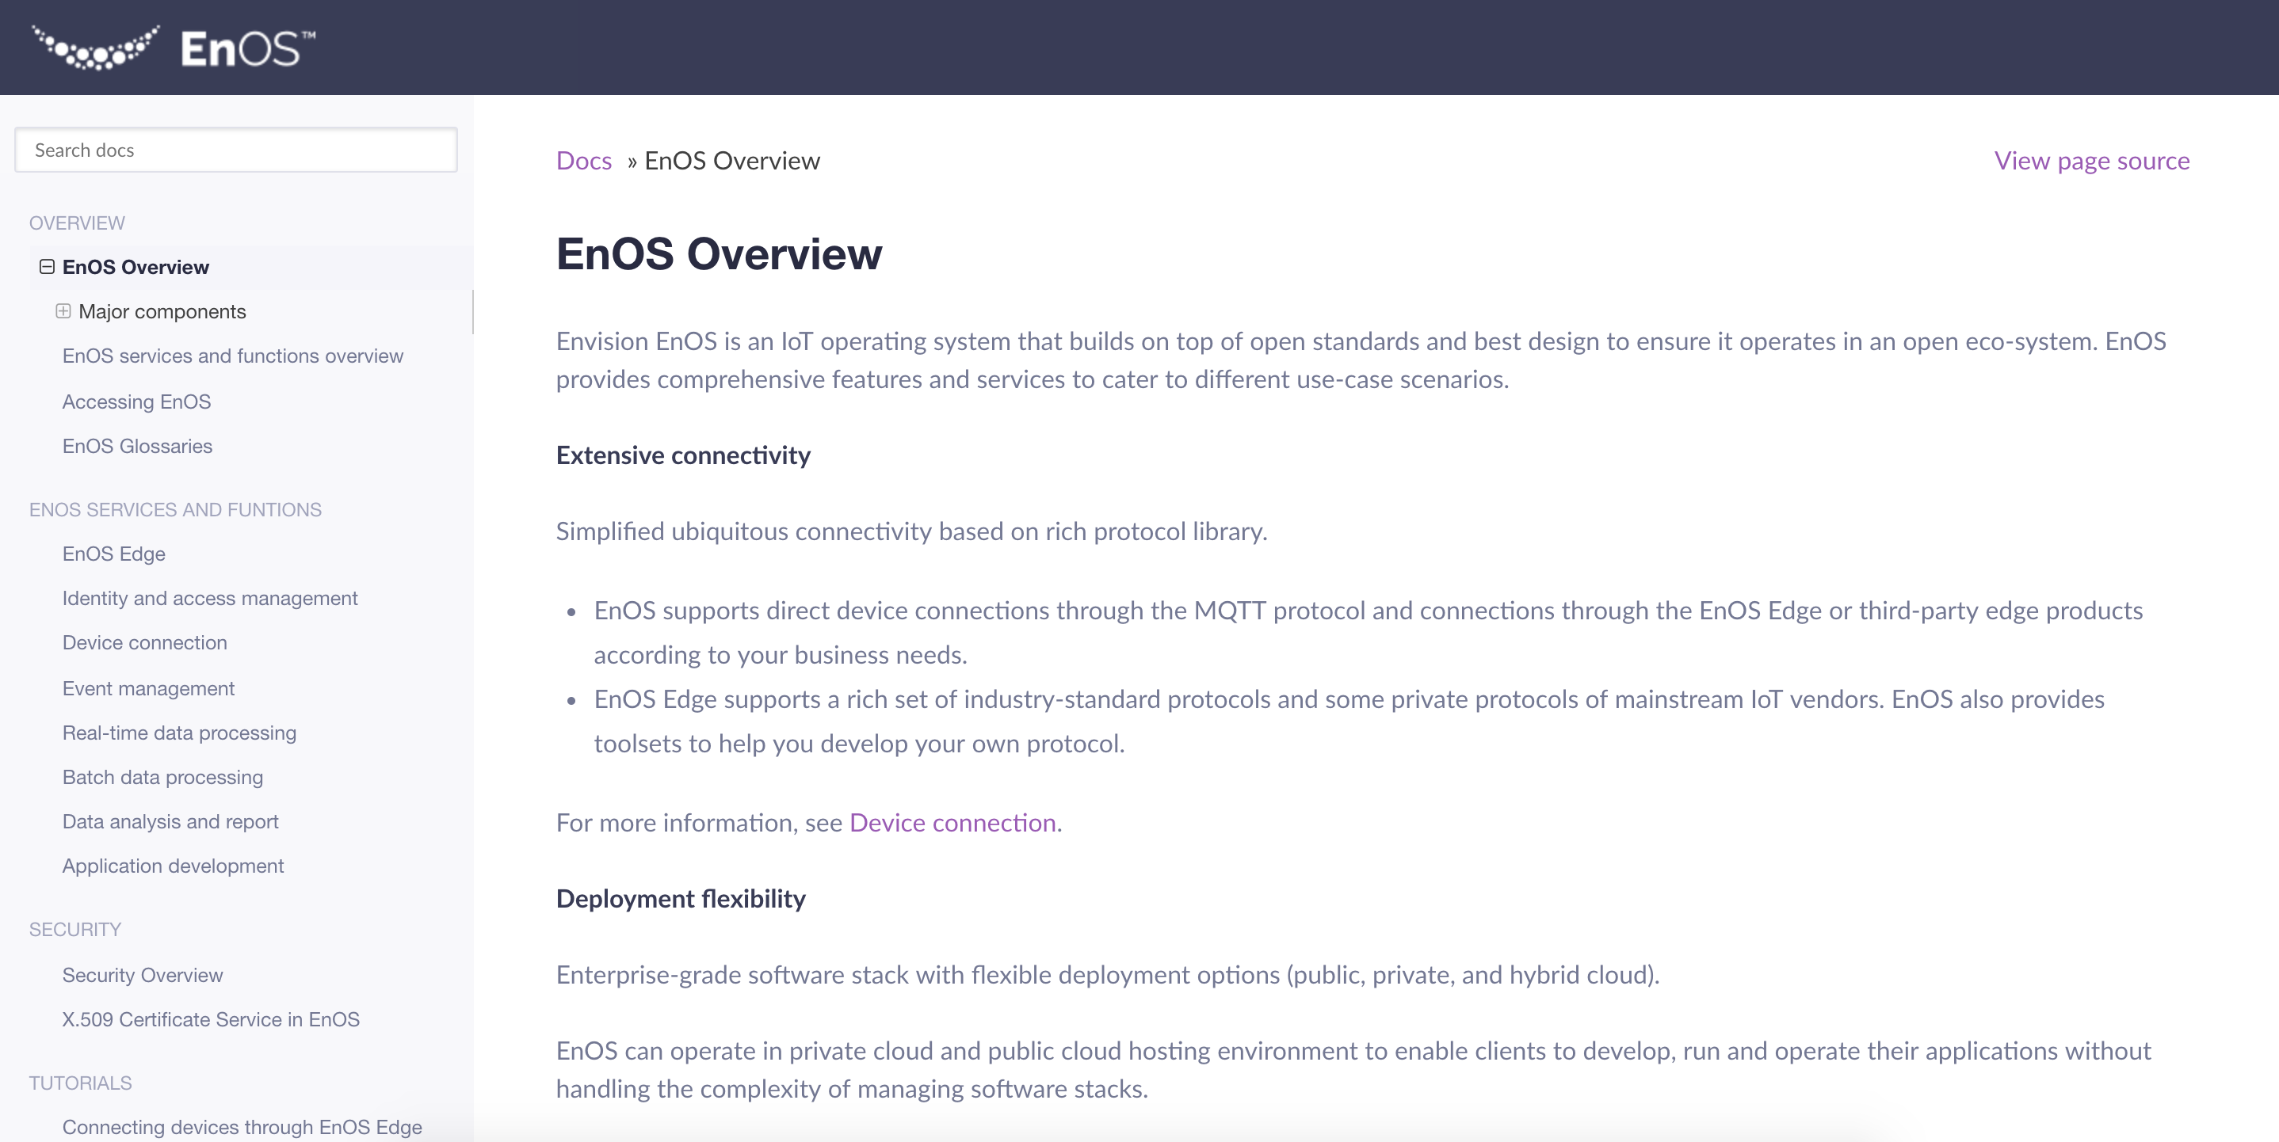
Screen capture
Pics of a display
Categories:
Screen capture
Annotated screen capture: callouts, thumbnail and zoom-in, numbered annotation
Animated screen capture
line：#F74C60 ， 2pt Solid Line
Title：#393C57 ，Helvetica or Arial 12pt Regular
Content：#393C57 ，Helvetica or Arial 12pt Light
If there is too much text, please wrap it according to the background frame. The spacing is 1x spacing by default.
Add Notes
Add Notes
Comment content 1
Comment content 2
Comment content 3

Slide 2
创建项目
创建应用
创建部署配置
创建流水线
创建服务配置和路由配置
创建配置字典并更新部署配置
运行流水线并查看结果
使用发布的服务

